Slide 1
PBD-02-000 NEW RULES & REGULATIONS
PARTNER.SHIP.REDEFINED.
2020-2021

Slide 2
NEW RULES & REGULATIONS All Cargo Vessels
MARITIME CYBER RISK MANAGEMENT
International Safety Management (ISM) Code
Entry into force: 01 January 2021
The Maritime Safety Committee, at its 98th session in June 2017, also adopted Resolution MSC.428(98) - Maritime Cyber Risk Management in Safety Management Systems.
Officers onboard must ensure that cyber risks are appropriately addressed in existing safety management systems (as defined in the ISM Code) no later than the first annual verification of the company’s Document of Compliance after 01 January 2021.

Slide 3
NEW RULES & REGULATIONS All Cargo Vessels
Nox Technical Code
Regulation 1.3
Entry into force: 01 October 2020
Electronic Record Books (eRB) as an alternative method to hard copy record books approved by the Administration in accordance with Guidelines, Res. MEPC.312(74) is accepted. This applies to the Record Book of Engine Parameters (Nox Technical Code).

Slide 4
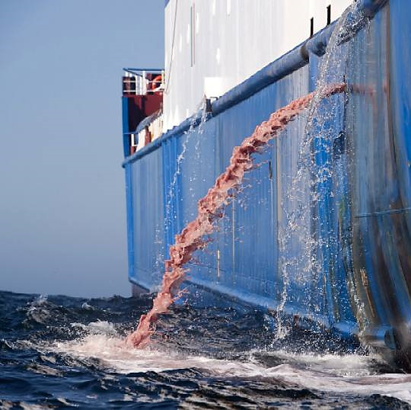
NEW RULES & REGULATIONS All Cargo Vessels
MARPOL
Annex I, II, IV and V
Entry into force: 01 October 2020
Electronic Record Books (eRB) as an alternative method to hard copy record books approved by the Administration in accordance with Guidelines, Res. MEPC.312(74) is accepted. This applies to the MARPOL record books

Slide 5
NEW RULES & REGULATIONS All Cargo Vessels
BWMS Code (Ballast Water Management System)
A-1 (New para. 8) & D-3
Installations on or after 28 October 2020
Ballast water management systems installed on or after 28 October 2020 shall be in compliance with the BWMS Code (Res. MEPC.300(72)). A unified interpretation of Appendix I clarifies that the “installed” means the contractual date of delivery of the ballast water management system. In absence of this date, actual date of delivery may be used.

Slide 6
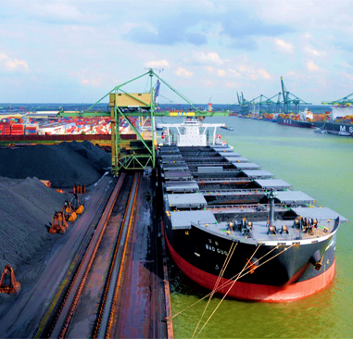
NEW RULES & REGULATIONS : All Cargo Vessels
International Maritime Solid Bulk Cargo (IMSBC) CODE
MSC.462 (101)
Entry into force: 01 January 2021
Key Changes: Characteristics table
Notes:
The next is the International Maritime solid bulk Cargo (IMSBC Code)
The IMSBC code is amended every two years, usually the odd number year. A key changes that came into force on the 1st January 2021 was communicated through MSC 462 (101)
The main changes is in the Characteristics Table. MSC 101/24/Add.3 Annex 7, page 4
What the slide here is showing is the old characteristics table (Pre 2021) on the top and new version on the bottom
IMSBC have included two extra columns: (MSC.1/Circ.1453/Rev.1)
Subsidiary Risk - This column should be used to specify the hazard(s) of the material relevant for sea transport, such as combustibility, toxicity, corrosivity, radiotoxicity, hygroscopy, liability to oxygen depletion, decomposition, self-heating, spontaneous ignition, liquefaction, emission of flammable and/or toxic gases or vapor's, reactivity with water, fuel oil or other organic materials.
Material Hazardous in Bulk. - If the cargo class is MHB and the existing hazard corresponding to the cargo does not meet any of the hazards identified in section 9.2.3 of the IMSBC Code, the other hazard (OH) corresponding to that cargo should be described in detail.
In case of non-hazardous cargo, write "No special hazards". If the cargo is non-combustible or constitutes a low fire-risk, write "This cargo is non-combustible or has a low fire-risk".

Slide 7
NEW RULES & REGULATIONS : All Cargo Vessels
International Maritime Solid Bulk Cargo (IMSBC) CODE
MSC.462 (101)
Entry into force: 01 January 2021
Key Changes:
Bauxite
Fines, Group A
Group C
Additional Test procedure to determine TML
Addition / deletion of entries
Fixed gas fire extinguishing system
(FLUE DUST, CONTAINING LEAD AND ZINC
MATTE CONTAINING COPPER AND LEAD
ZINC OXIDE ENRICHED FLUE DUST)
Notes:
The next is the International Maritime solid bulk Cargo (IMSBC Code)
Another change is for the Bauxite cargo
This kind of cargo was being carried by Bulk Jupiter when it sank last 2015.
Now, the changes for this cargo is that they split this into two groups:
Group A – A fine Bauxite which tends to liquefy
Group C – which cargo does not liquefy
There is also additional test procedures to determine the Transportable Moisture Limit of Bauxite cargo to determine which group the cargo belongs.
There are also cargoes that are added and removed. New entries include FLUE DUST, BAUXITE FINES, and BRUCITE. One entry, SEED CAKE (non-hazardous), is deleted.
“The List of solid bulk cargoes for which a fixed gas fire extinguishing system may be exempted or for which a fixed gas fire extinguishing system is ineffective” is amended to add several cargoes.
If the vessel is issued an exemption certificate, this should be checked if the new cargoes added are included, especially if the vessel would carry these cargoes.

Slide 8
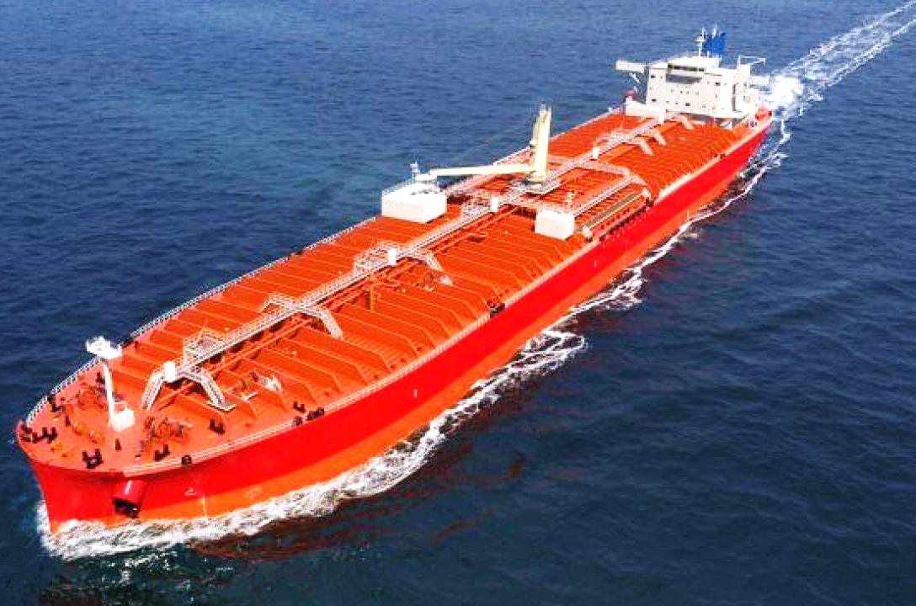
NEW RULES & REGULATIONS : All Chemical Tankers
MARPOL ANNEX II and IBC code
MEPC 74 and MSC 101
Entry into force: 01 January 2021
Key Changes:
IBC code
Carriage of H₂S detection equipment
New criteria for carriage requirement, amendment to certificate
MARPOL Annex II
Persistent floater
Prewash requirement
Procedures and Arrangement (P&A) Manual
Notes:
The next one is for Chemical tankers. There are changes in Marpol Annex II and the IBC code
Let’s take a look at the amendments for Chapter 15 and Chapter 21 of the IBC Code.
For Chapter 15, the amendment includes the requirement for Hydrogen Sulfide (H₂S) detection equipment to be carried on board for the vessels carrying bulk liquids prone to hydrogen Sulfide ( H₂S) formation.
For Chapter 21, the amendment includes the implementation of the new criteria for carriage requirements for some products listed in the IBC code.
This in turn would affect the vessel’s certificate – the Certificate of Fitness or Noxious Liquid Substances (N.L.S) certificate.
The Deck officers should check the applicable certificates
For MARPOL annex II
The term “persistent floater” is added. These are cargoes like vegetable oil or paraffin are slick forming substances.
The amendment also includes additional prewash requirement for persistent floaters discharged in North European ports.
Cargo residues of persistent floaters in this area are required to be discharged only to a shore reception facility.
A new paragraph also added to MARPOL Annex II Regulation 13 – Control of discharges of residues of noxious liquid substances, to require prewash and discharge of residue/water mixture generated during the prewash to a reception facility, for specific products, in specified areas (North West European waters, Baltic Sea area, Western European waters and Norwegian Sea).
Appendix IV has been amended to include in the vessel’s Procedures and Arrangement (P&A) Manual to incorporate prewash procedures for persistent floaters.
Gentlemen, that completes the new changes to the Rules and Regulations.
Remember that rules and regulations are constantly changing so please be aware and keep updated.

Slide 9
THANK YOU!

Slide 10
DISCLAIMER
Content within this presentation is for preliminary informational purposes only and should not be regarded as offering a complete and final explanation/advice of all content and material referred.
This document contains data and information provided as seen, and at the time of production. Marlow Navigation reserves the right to amend/update such content based on new data and information in order to be most relevant at a given period, and as such, assumes no liability for accuracy of content within. Such is the nature of the maritime industry, that commercial figures and KPIs are dynamic and changing on a regular basis.
Copyright Notice
Material, content and work found on this Marlow Navigation presentation is copyright to Marlow Navigation Co Ltd.
Content & Data

